Slide 1

Horizon Electric Project
Manpower Scheduling Board

Slide 2
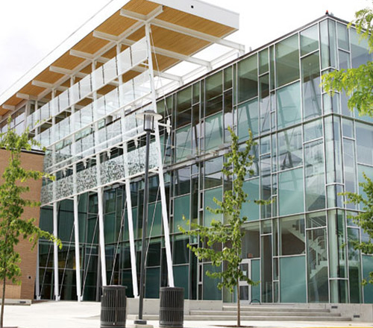
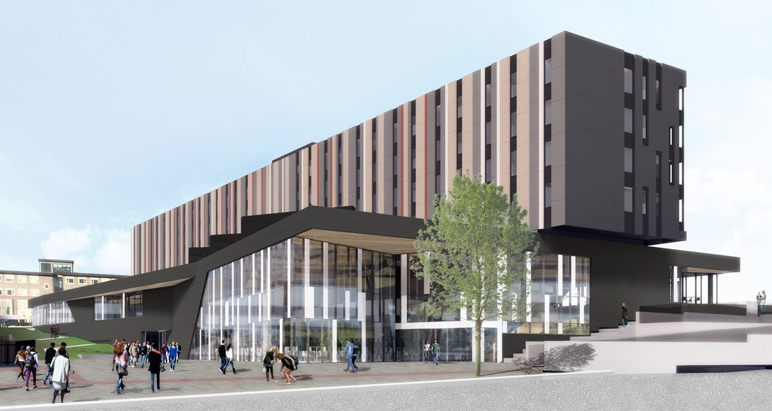
Horizon Electric
Full service electrical contractor
Worked on projects such as Nechako and the RHS building at UBCO
Notes:
~1 minute - Edwin
Hello, and thank you for listening in to our presentation of our current assignment. We are tasked with making a manpower scheduling board for our client which is Horizon Electric Inc.
Horizon Electric is a full-service electrical contractor serving the Okanagan Valley and surrounding areas who has worked on many projects including contracts on the University such as the Nechako Residence Building as well as the Health and Exercise Science building.
Our project as software developers is to help Horizon Electric digitize their current manpower scheduling board which is currently literally a whiteboard with magnets stuck on.

Slide 3
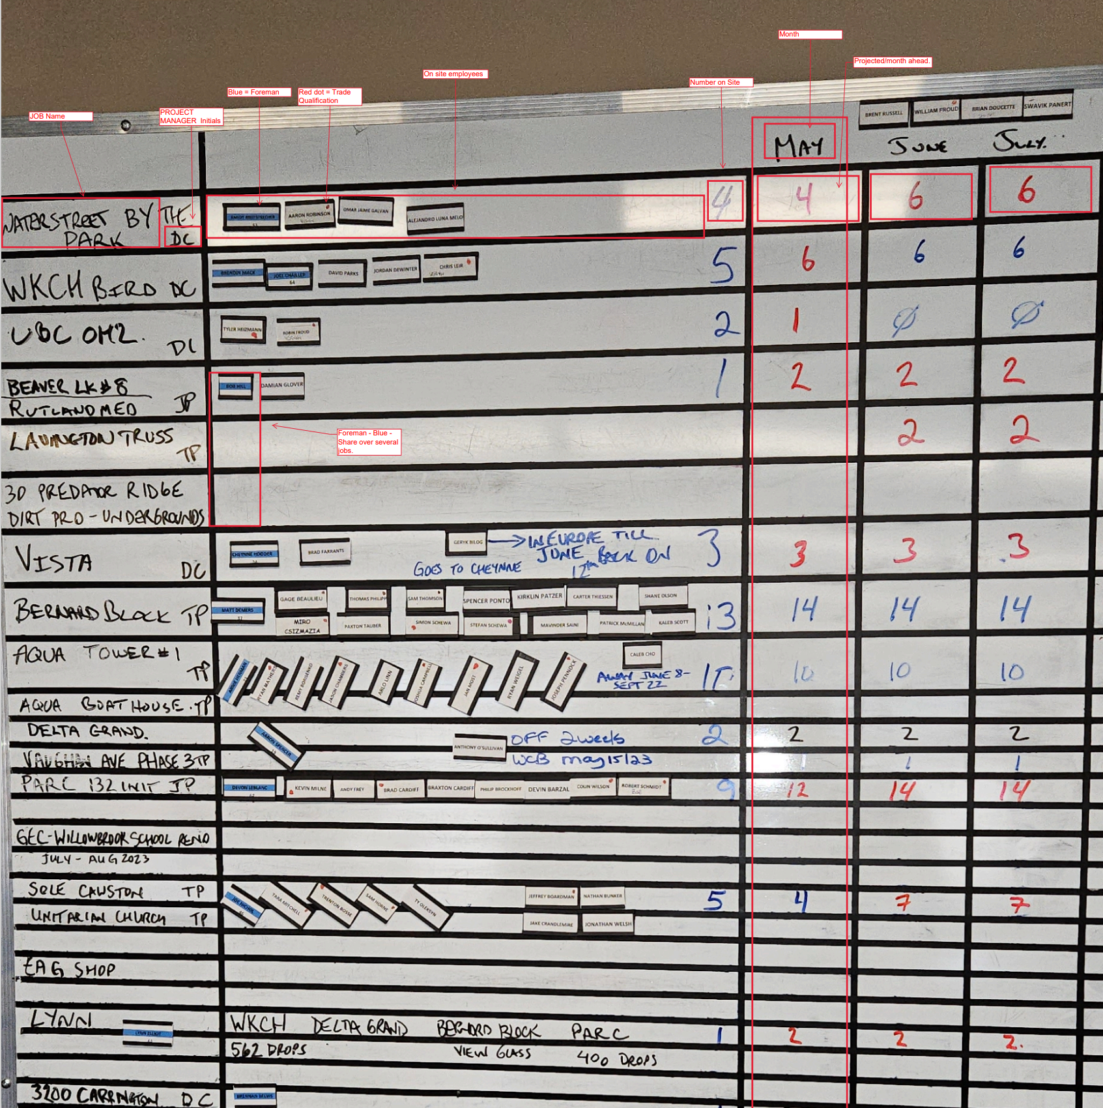
Current System
Whiteboard and magnets!
What's bad:
Too small for number of jobs, outlook and employees.
Crowded and hard to understand.
Limited outlook
No analytics or history
What's good:
Simple
Easy to use
Cheap
Notes:
~2 Minutes JORDAN
As you can see from the picture. This is the current system that Horizon managers are using to allocate their employees. While it’s functional, it is also completely manual and has no useful features such as a history of jobs or insights into their current assignments. The board is proving to be too small as the company grows, with limited space for increasing job and employee numbers. By implementing a more advanced digital system that supports these features, Horizon managers could more easily allocate their employees and keep track of their assignments. This would improve the efficiency and accuracy of the allocation process and could save the company money.

Slide 4
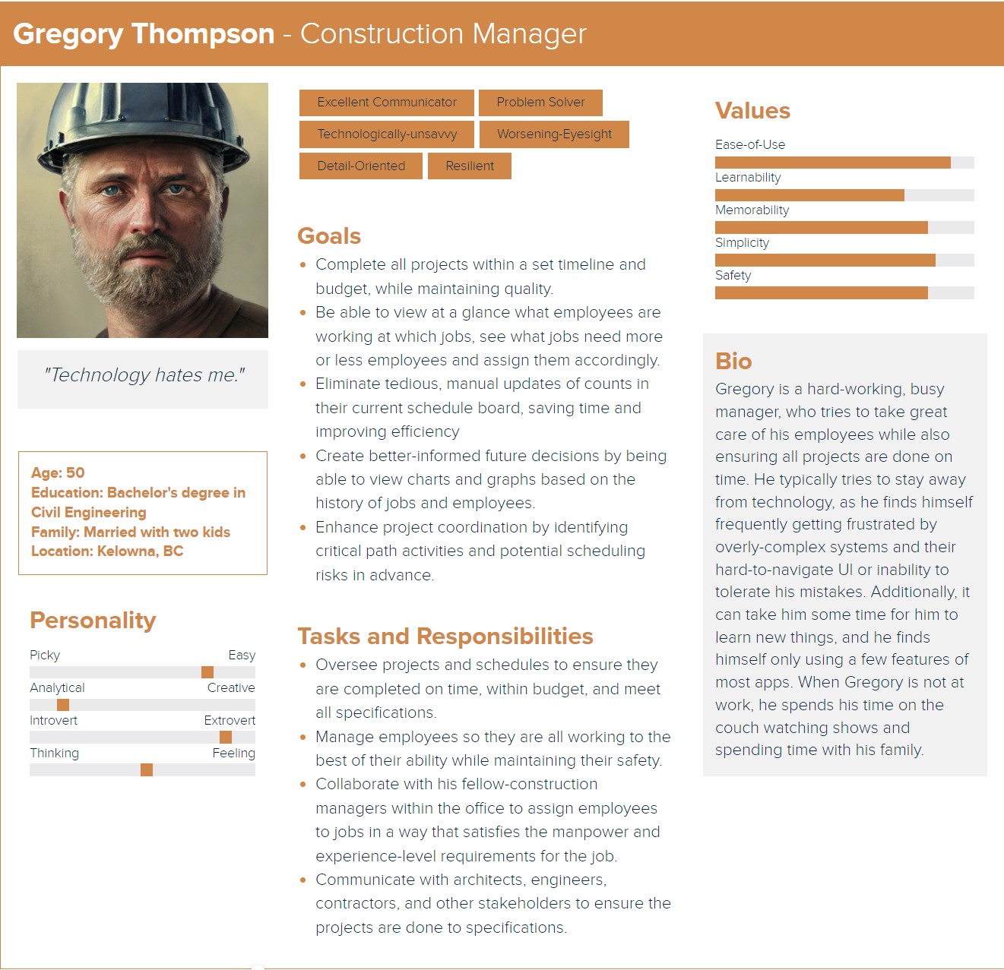
Notes:
Adam – 1min One of the coolest parts of this project, in my opinion, is our main user group. Our primary user group are construction managers, who are typically older fellows who avoid technology and are unaware of what its capabilities are or how it works, and I think that's pretty realistic for future jobs. Here we have Gregory, who you might be able to get the vibe of just looking at him. He's not really looking for some kind of fancy pants software that has a ton of features, but would rather want something more simple and easy-to-learn, and especially safety, since he can make a lot of mistakes, where an undo system could be good.
Some of his goals are to be able to quickly view, at a glance, what employees are working which jobs, as well as the levels of expertise of said employees, and be able to move them around accordingly, without needing to worry about manually updating the count of employees or anything. Additionally, he hopes to be able to see the history of who has worked where or how many employees have been assigned to a job over time, that way he can create better decisions.

Slide 5
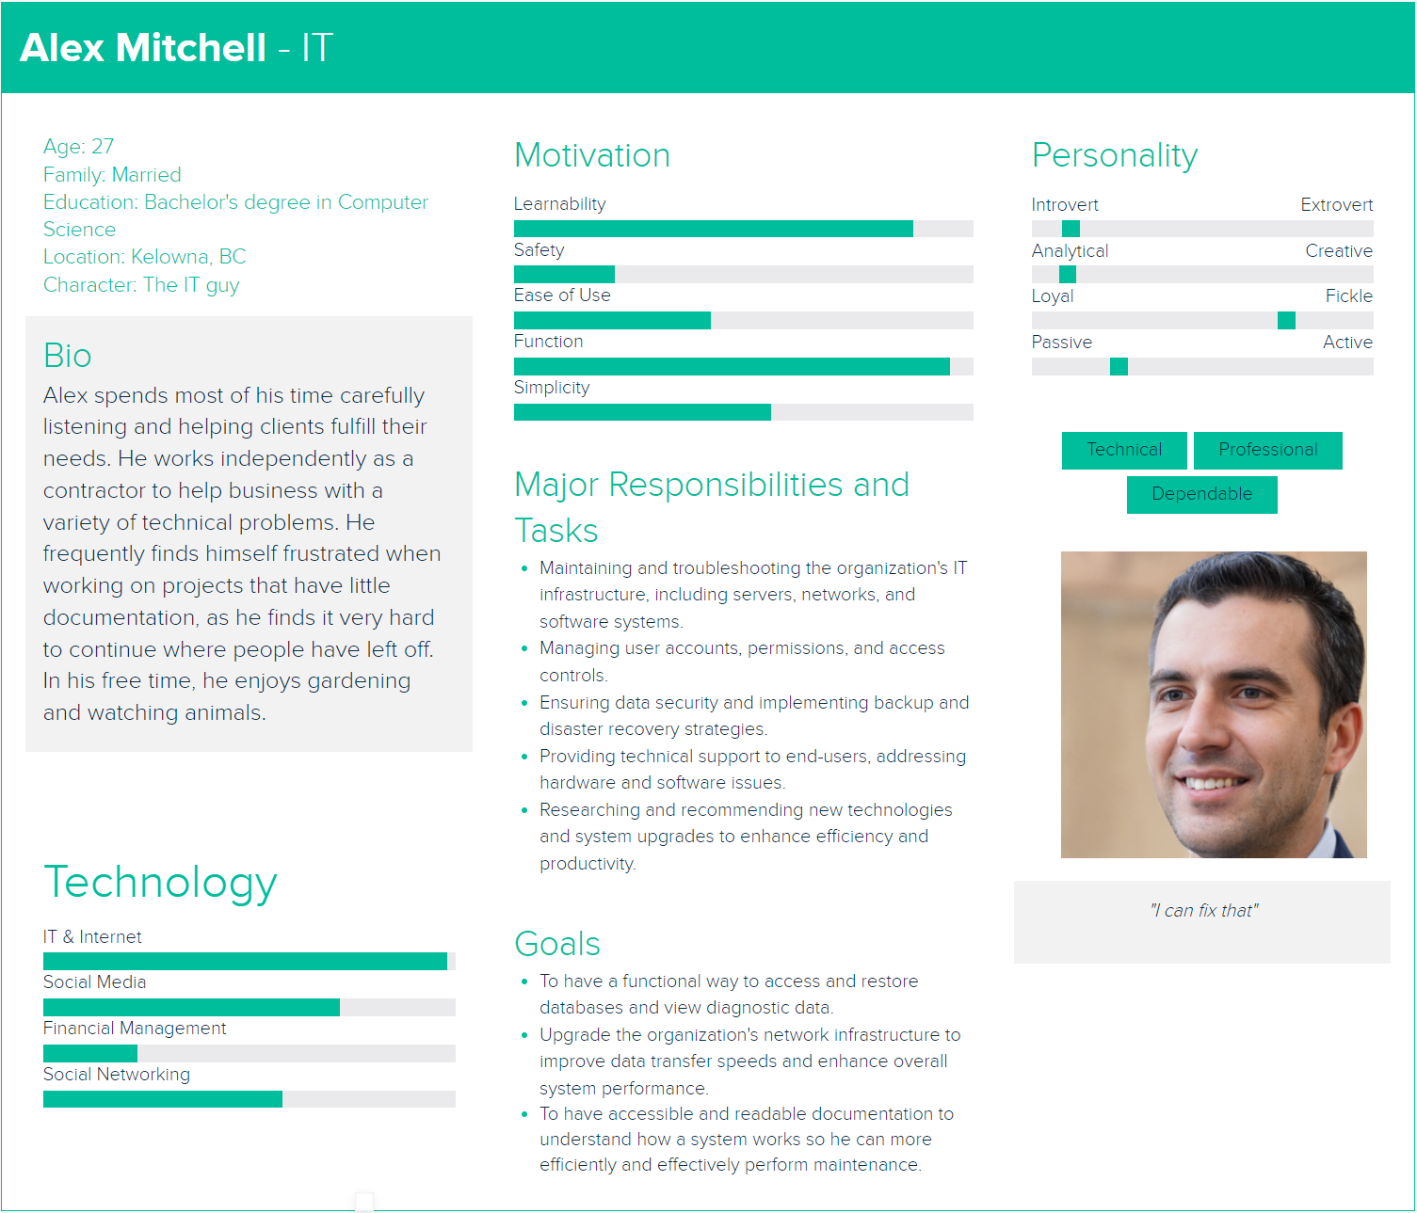
Notes:
Adam – 30 sec
As for a secondary user group, we have Alex, who is your typical sorta IT guy who might get called in to do maintence work on the system or load backups. His primary concerns is that there's good documentation, that way he can quickly get an idea on how the system works so he can do maintence.

Slide 6
Key Requirements
Moving employees between jobs and between statuses
Adding, editing, and archiving employees
Adding, editing, and archiving jobs
Allowing for editing of predicted number of assignments
History of previous jobs and generated visual graphs
The UI must be intuitive and responsive for people who may not be the most familiar with technology
Notes:
Yuan~1 Minute
As you may image, the ease of editing/adding jobs/employees is the key because the primary users have limited technology background. The construction managers edit daily, so they need easy access of adding/editing/archiving employees and jobs, also ease of moving employees between jobs and between status. The product UI needs to be easily understood because the users have limited technology background. In addition, the prediction of number of assignments and visualization of history of previous jobs are extra great features for them to use.

Slide 7
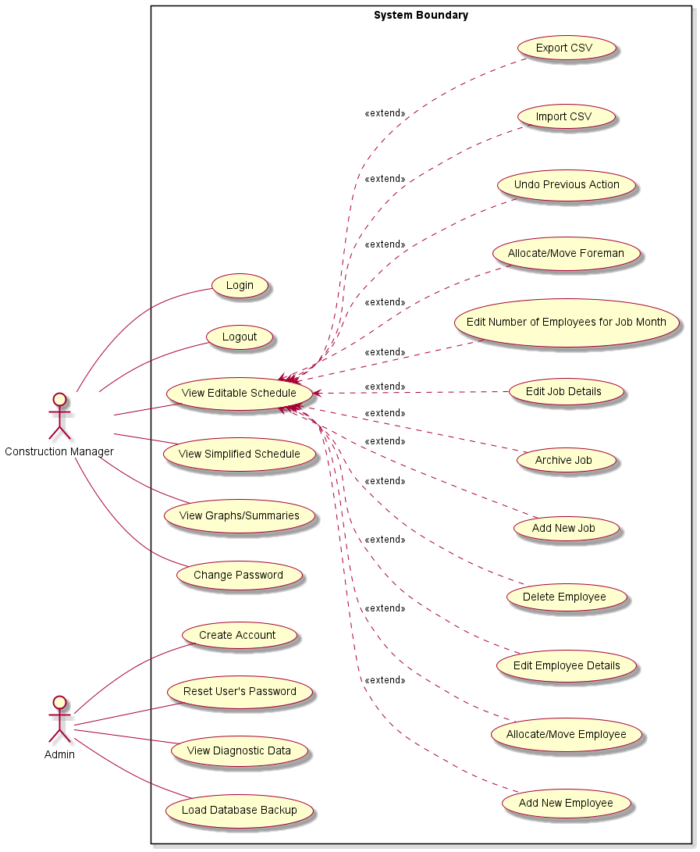
Notes:
Adam - 1min Here is a view of our use case diagram, where we have sorta two different user types: an admin and our main user. For use cases, other than the typical account thingos, a lot of these things were already mentioned, but to list a few, we have stuff like being able to create, archive jobs and edit their projected employees; Create, edit, and delete employees; as well as view a simplified schedule, which is meant to be a simplified view that will be shown on their projector.
Some other use cases include users being able to view graphs and summaries with the data we gathered, as well as being able to import a csv of their old employee information, with the ability to export that later if they would like as well. And of course, we have the ability to undo on there, plus some other admin use cases like viewing diagnostic data or loading database backups.

Slide 8
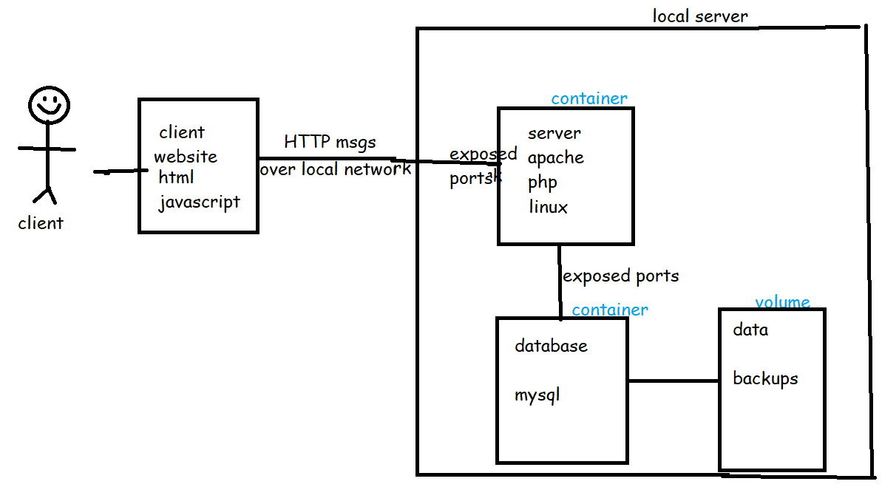
Architecture Diagram
Notes:
Adam - 45secs This is our architecture diagram. I'm not sure if any of you have taken COSC 360, but it's essentially that. Our program will be web-based, with the web server and database on some containers on their local server, which is unique, in that their server is basically in the same room as their computers, which means it is all local. As you can see by the diagram, within the local server, our containerised web server will talk to the containerised database, who stores data backups on the server's hard disk. Additionally, we'll be using the LAMP stack, (Linux, Apache, MySQL, and PHP) to implement all of these.

Slide 9
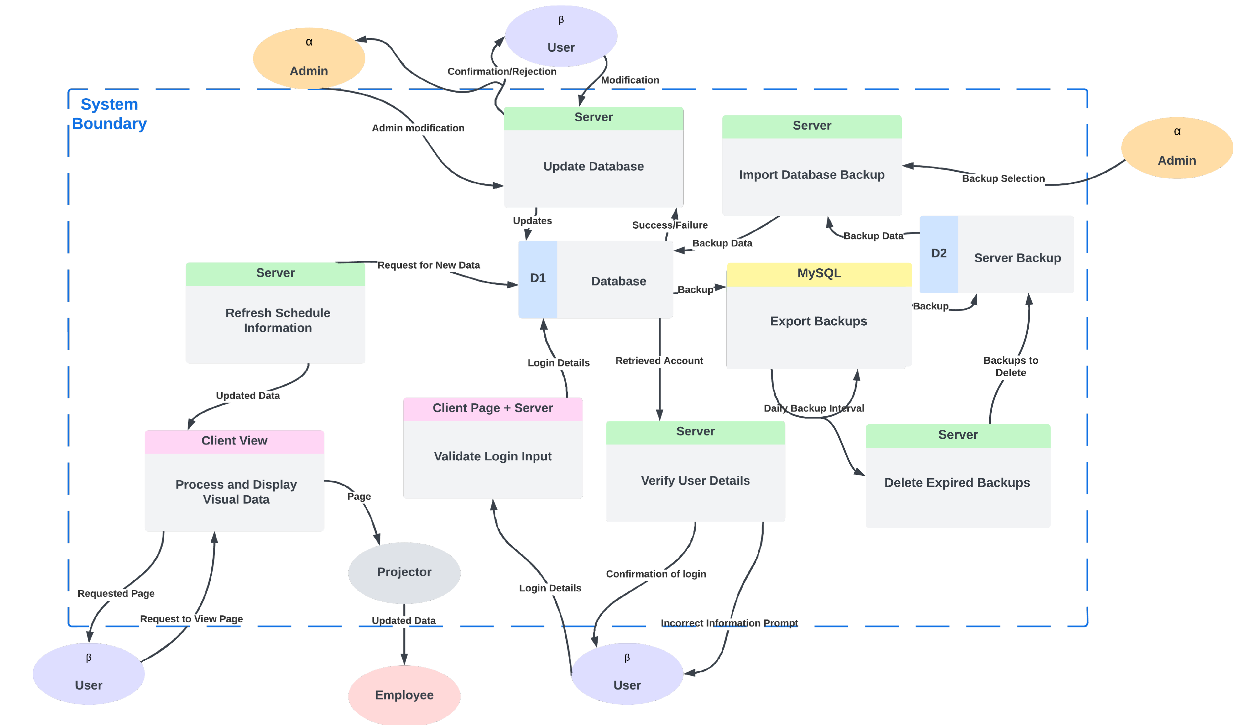
How the Data Flows
Notes:
~1 Minute JORDAN
Log in validates correct format client and server side
Sends the data to the database to check if user exists
Server verifies that all data matches
Users will be able to edit employees and jobs, as well as add and delete old ones.
Admins will be able to create and edit user accounts.
These statements will be ran through the database by server-side PHP Scripts
PHPMyAdmin will export a backup daily, when that occurs backups older than a specified age will be deleted.
Admins can import backups in case of emergency.
The whiteboard at the office will be physically replaced with a projector that will regularly update with new changes, this is also viewable by users.

Slide 10
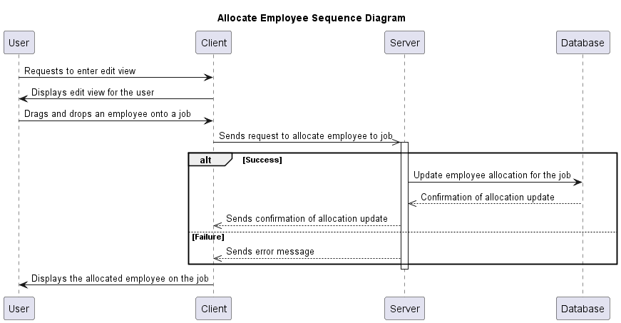
Sequence Diagram
Notes:
This is the sequence diagram for allocate employee. Most of our sequence diagrams follow a similar process:
The user sends a request to change/create something by submitting a forum or clicking a button
The client handles that request, passes the data to the server
The server validates data, if succeed, retrieve data from database, display changed state to the user, or if validation fails, an error message wil be displayed.

Slide 11
Proposed Tech Stack
Frontend: HTML, CSS, JS
Backend: PHP
Database: MySQL
Testing: PHP Unit
CI/CD: Docker, Github Actions
Other frame works, such as Jquery
Notes:
Due to time constraint/concerns for the learning curve for new technologies, we decide to stick with technologies that most of our group members are comfortable with.

Slide 12
Testing Plan
Unit testing
Integration testing
User testing
Regression testing
Notes:
Unit testing:
-Make sure all components fulfill the functional requirements. Each component is tested in isolation to verify its behavior, inputs, and outputs. Happens during the whole development phase, ideally tests are written before actual implementation of individual components.
Integration testing:
-When two components merge, they should pass their respective unit tests, this is to make sure that these components interact with each other properly
User testing:
-Provide a prototype to our clients, observe their interactions with it, take feed backs. The purpose of user testing is to make sure that the project fulfill key non-functional requirement, especially the user firendliness.
Regression testing:
-

Slide 13

How is it going to look
Figma File
Notes:
~3 minutes - Edwin
This part would be completed in Figma, not in PowerPoint.
Edwin goes over UI mock-up in Figma – 3 mins
How the drag and drop works
How the layout makes sense
Difference between projector and edit views
Visual display of the graphs
How pins work

Slide 14
Conclusion and Q&A
Please ask us questions, unless it’s been more than 12.5 minutes.

